Slide 1
Chapter 3
Arithmetic for Computers
Notes:
Morgan Kaufmann Publishers
Chapter 3 — Arithmetic for Computers

Slide 2
Arithmetic for Computers
§3.1 Introduction
Operations on integers
  Addition and subtraction
  Multiplication and division
  Dealing with overflow
Floating-point real numbers
  Representation and operations
Chapter 3 — Arithmetic for Computers — <number>
Notes:
Morgan Kaufmann Publishers
Chapter 3 — Arithmetic for Computers

Slide 3

Integer Addition
Example: 7 + 6
§3.2 Addition and Subtraction
Overflow if result out of range
  Adding +ve and –ve operands, no overflow
  Adding two +ve operands
    Overflow if result sign is 1
  Adding two –ve operands
    Overflow if result sign is 0
Chapter 3 — Arithmetic for Computers — <number>
Notes:
Morgan Kaufmann Publishers
Chapter 3 — Arithmetic for Computers

Slide 4
Integer Subtraction
Add negation of second operand
Example: 7 – 6 = 7 + (–6)
  +7: 0000 0000 … 0000 0111
  –6: 1111 1111 … 1111 1010
  +1: 0000 0000 … 0000 0001
Overflow if result out of range
  Subtracting two +ve or two –ve operands, no overflow
  Subtracting +ve from –ve operand
    Overflow if result sign is 0
  Subtracting –ve from +ve operand
    Overflow if result sign is 1
Chapter 3 — Arithmetic for Computers — <number>
Notes:
Morgan Kaufmann Publishers
Chapter 3 — Arithmetic for Computers

Slide 5
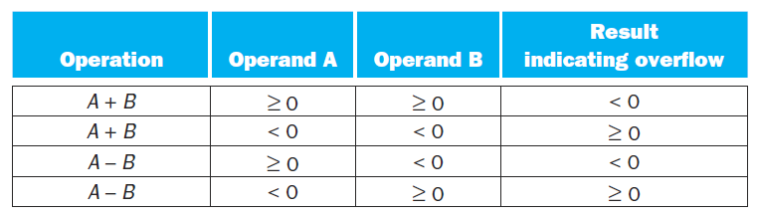
Dealing with Overflow
Chapter 3 — Arithmetic for Computers — <number>

Slide 6
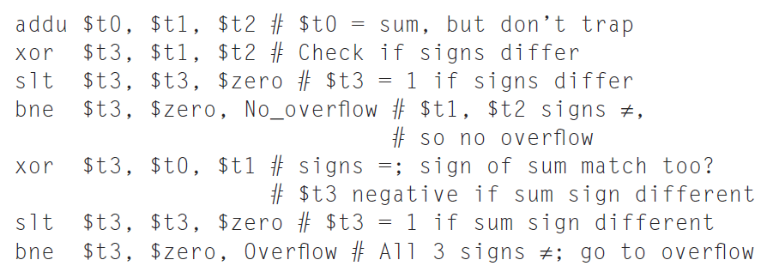
Dealing With Signed Number (Integer Addition)
Chapter 3 — Arithmetic for Computers — <number>

Slide 7
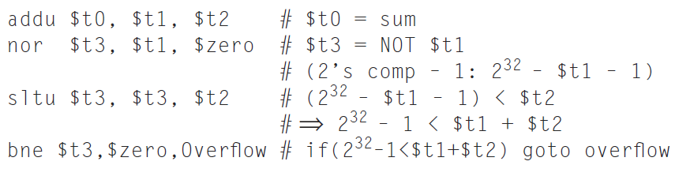
Dealing With Unsigned Number
(Integer Addition)
Chapter 3 — Arithmetic for Computers — <number>

Slide 8

Multiplication
§3.3 Multiplication
Start with long-multiplication approach
multiplicand
1000
× 1001
1000
0000
0000
1000
1001000
multiplier
product
Length of product is the sum of operand lengths
Chapter 3 — Arithmetic for Computers — <number>
Notes:
Morgan Kaufmann Publishers
Chapter 3 — Arithmetic for Computers

Slide 9

Multiplication Hardware
Initially 0
Chapter 3 — Arithmetic for Computers — <number>
Notes:
Morgan Kaufmann Publishers
Chapter 3 — Arithmetic for Computers

Slide 10
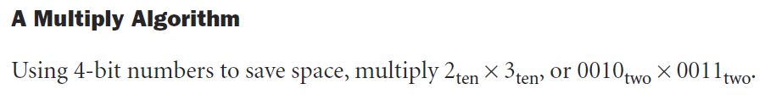
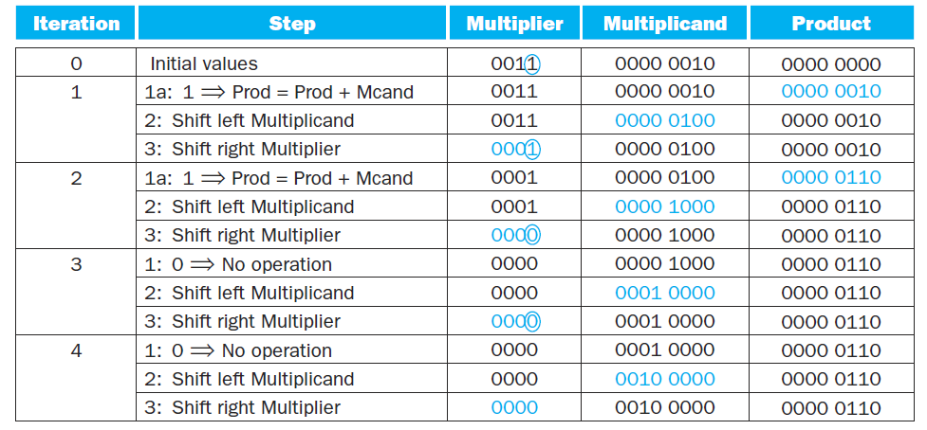
Multiply Algorithm
Chapter 3 — Arithmetic for Computers — <number>

Slide 11

Optimized Multiplier
Perform steps in parallel: add/shift
One cycle per partial-product addition
  That’s ok, if frequency of multiplications is low
Chapter 3 — Arithmetic for Computers — <number>
Notes:
Morgan Kaufmann Publishers
Chapter 3 — Arithmetic for Computers

Slide 12
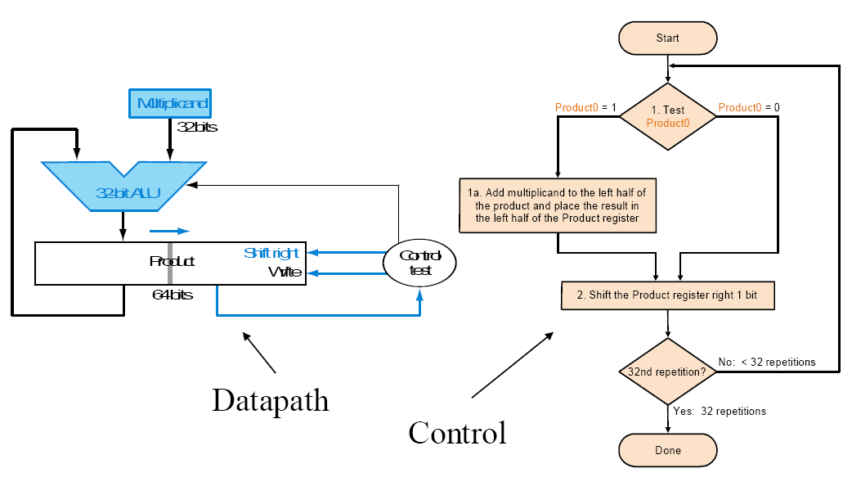
Optimized Multiplier
Chapter 3 — Arithmetic for Computers — <number>
Notes:
Morgan Kaufmann Publishers
Chapter 3 — Arithmetic for Computers

Slide 13
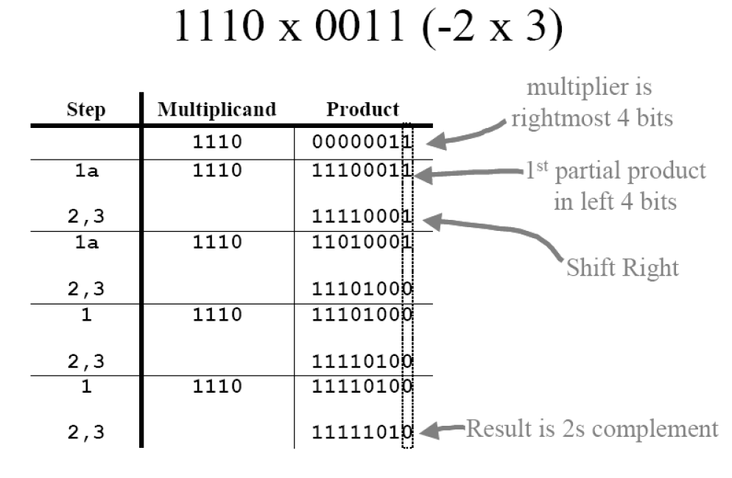
Optimized Multiplier
Chapter 3 — Arithmetic for Computers — <number>
Notes:
Morgan Kaufmann Publishers
Chapter 3 — Arithmetic for Computers

Slide 14
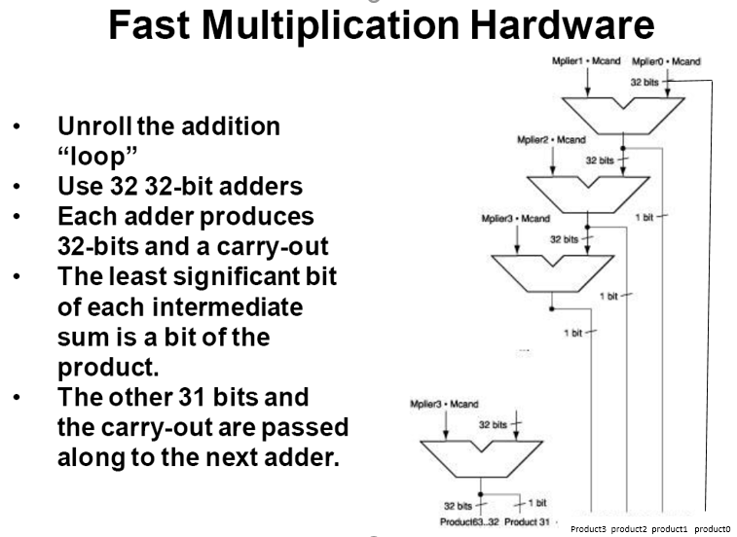
Faster Multiplier
31
Chapter 3 — Arithmetic for Computers — <number>
Notes:
Morgan Kaufmann Publishers
Chapter 3 — Arithmetic for Computers

Slide 15
MIPS Multiplication
Two 32-bit registers for product
  HI: most-significant 32 bits
  LO: least-significant 32-bits
Instructions
  mult rs, rt / multu rs, rt
    64-bit product in HI/LO
  mfhi rd / mflo rd
    Move from HI/LO to rd
    Can test HI value to see if product overflows 32 bits
  mul rd, rs, rt
    Least-significant 32 bits of product –> rd
Chapter 3 — Arithmetic for Computers — <number>
Notes:
Morgan Kaufmann Publishers
Chapter 3 — Arithmetic for Computers

Slide 16
Division
§3.4 Division
Check for 0 divisor
Long division approach
  If divisor ≤ dividend bits
    1 bit in quotient, subtract
  Otherwise
    0 bit in quotient, bring down next dividend bit
Restoring division
  Do the subtract, and if remainder goes < 0, add divisor back
Signed division
  Divide using absolute values
  Adjust sign of quotient and remainder as required
quotient
dividend
1001
1000 1001010
-1000
10
101
1010
-1000
10
divisor
remainder
n-bit operands yield n-bit
quotient and remainder
Chapter 3 — Arithmetic for Computers — <number>
Notes:
Morgan Kaufmann Publishers
Chapter 3 — Arithmetic for Computers

Slide 17


Division Hardware
Initially divisor in left half
Initially dividend
Chapter 3 — Arithmetic for Computers — <number>
Notes:
Morgan Kaufmann Publishers
Chapter 3 — Arithmetic for Computers

Slide 18
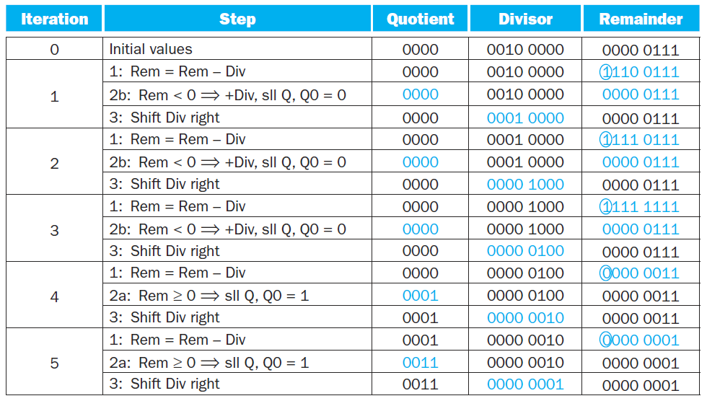
Division Algorithm
Chapter 3 — Arithmetic for Computers — <number>

Slide 19
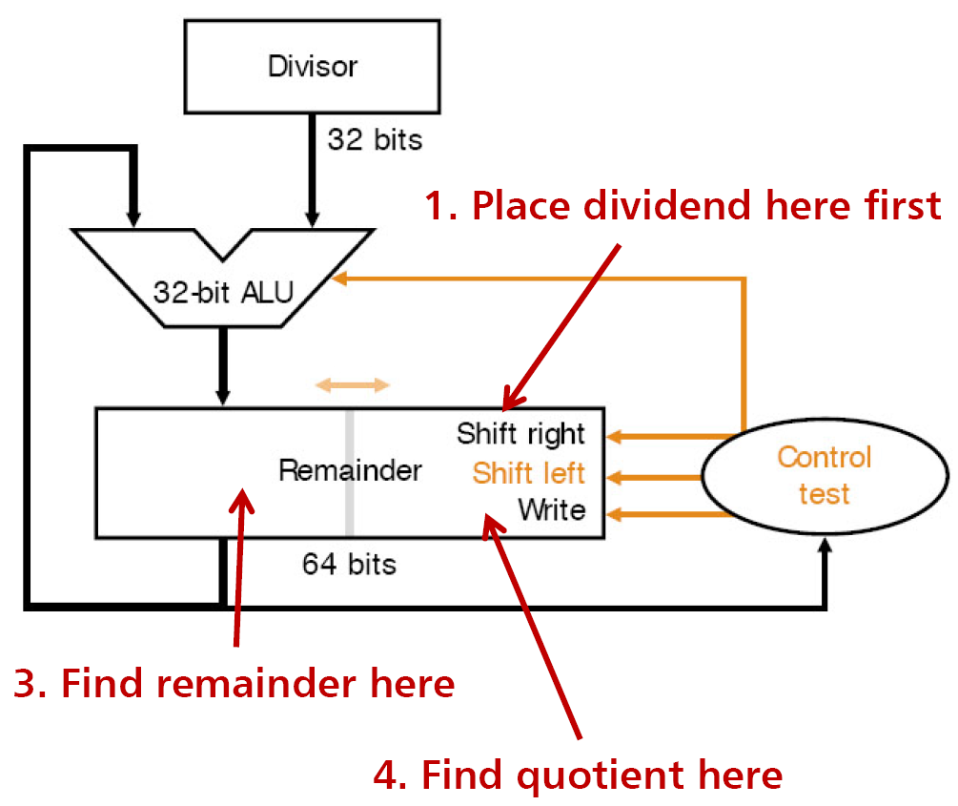
Optimized Divider
Looks a lot like a multiplier!
  Same hardware can be used for both
Notes:
Morgan Kaufmann Publishers
Chapter 3 — Arithmetic for Computers

Slide 20
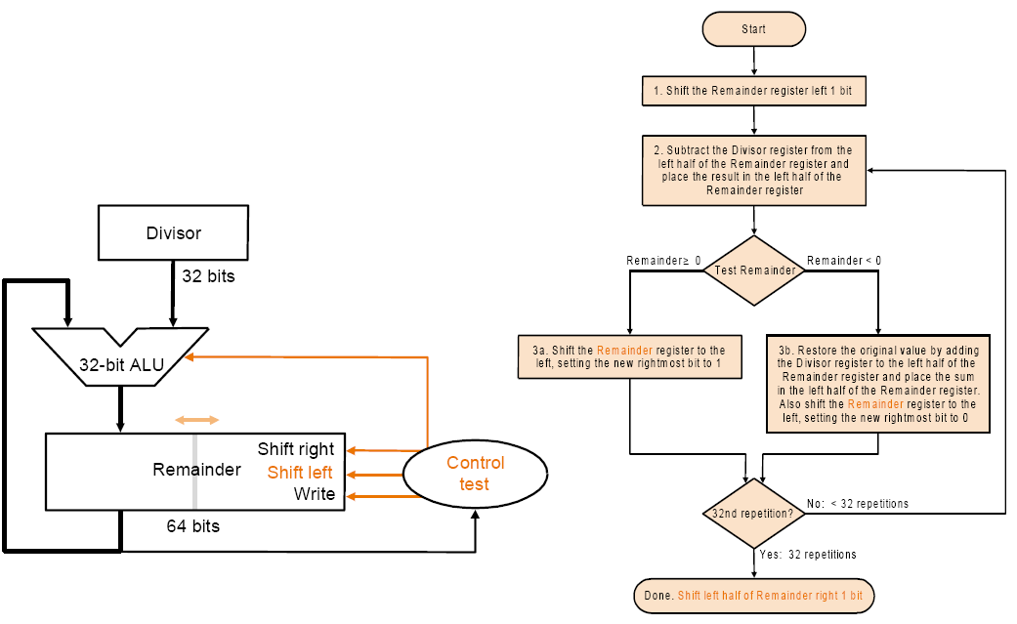
Optimized Divider
Chapter 3 — Arithmetic for Computers — <number>
Notes:
Morgan Kaufmann Publishers
Chapter 3 — Arithmetic for Computers

Slide 21
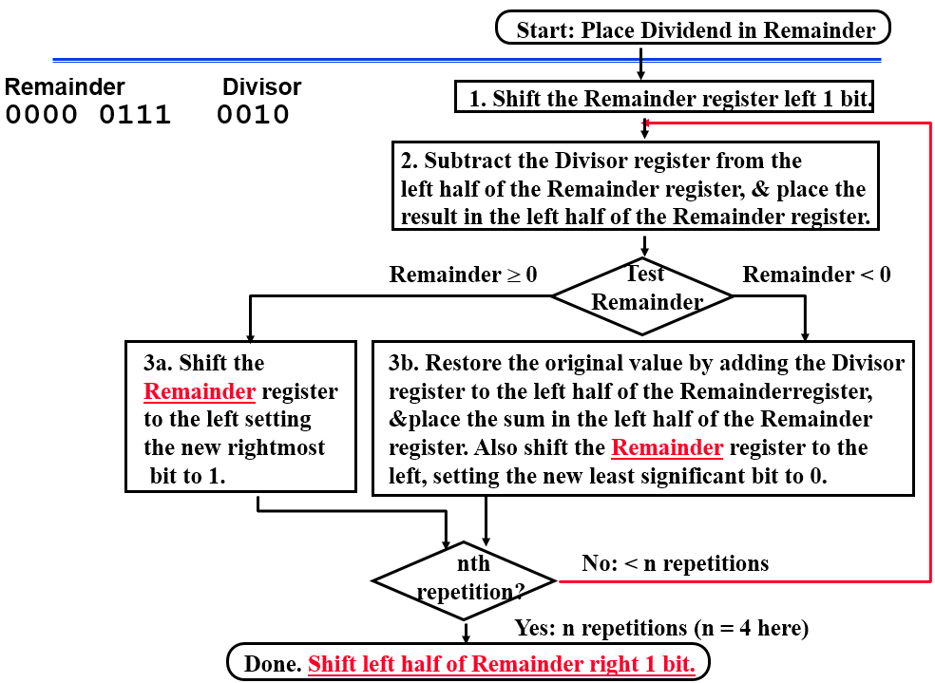
Optimized Divider
Notes:
Morgan Kaufmann Publishers
Chapter 3 — Arithmetic for Computers

Slide 22
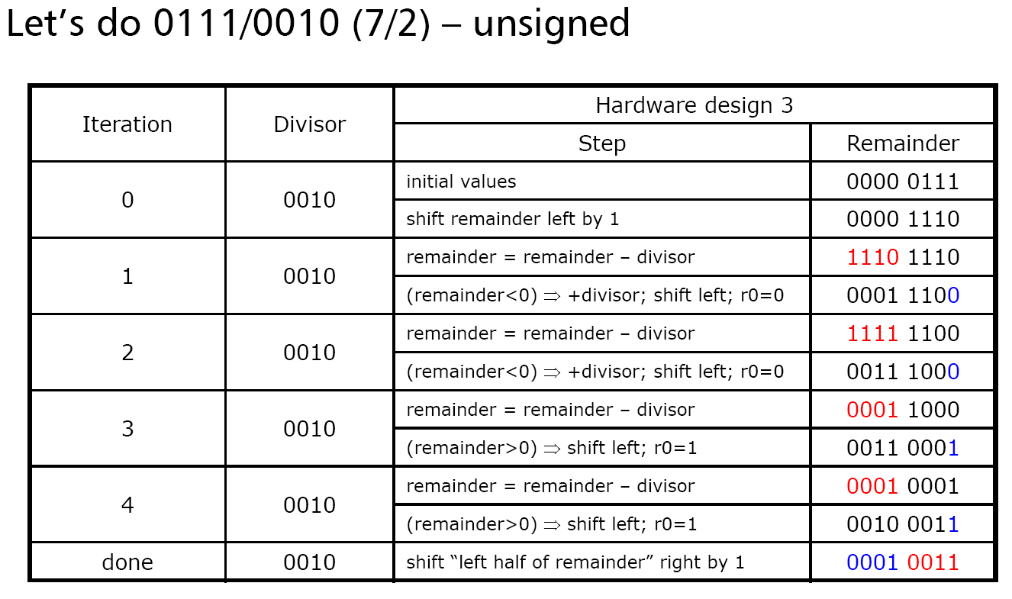
Optimized Divider
Chapter 3 — Arithmetic for Computers — <number>
Notes:
Morgan Kaufmann Publishers
Chapter 3 — Arithmetic for Computers

Slide 23
MIPS Division
Use HI/LO registers for result
  HI: 32-bit remainder
  LO: 32-bit quotient
Instructions
  div rs, rt / divu rs, rt
  No overflow or divide-by-0 checking
    Software must perform checks if required
  Use mfhi, mflo to access result
Chapter 3 — Arithmetic for Computers — <number>
Notes:
Morgan Kaufmann Publishers
Chapter 3 — Arithmetic for Computers

Slide 24
Floating Point
§3.5 Floating Point
Representation for non-integral numbers
  Including very small and very large numbers
Like scientific notation
  –2.34 × 10⁵⁶
  +0.002 × 10^{–4}
  +987.02 × 10⁹
In binary
  ±1.xxxxxxx₂ × 2^{yyyy}
Types float and double in C
normalized
not normalized
Chapter 3 — Arithmetic for Computers — <number>
Notes:
Morgan Kaufmann Publishers
Chapter 3 — Arithmetic for Computers

Slide 25
Floating Point Standard
Defined by IEEE Std 754-1985
Developed in response to divergence of representations
  Portability issues for scientific code
Now almost universally adopted
Two representations
  Single precision (32-bit)
  Double precision (64-bit)
Chapter 3 — Arithmetic for Computers — <number>
Notes:
Morgan Kaufmann Publishers
Chapter 3 — Arithmetic for Computers

Slide 26
IEEE Floating-Point Format
single: 8 bits
double: 11 bits
single: 23 bits
double: 52 bits
S
Exponent
Fraction
S: sign bit (0 ⇒ non-negative, 1 ⇒ negative)
Normalize significand: 1.0 ≤ |significand| < 2.0
  Always has a leading pre-binary-point 1 bit, so no need to represent it explicitly (hidden bit)
  Significand is Fraction with the “1.” restored
Exponent: excess representation: actual exponent + Bias
  Ensures exponent is unsigned
  Single: Bias = 127; Double: Bias = 1203
Chapter 3 — Arithmetic for Computers — <number>
Notes:
Morgan Kaufmann Publishers
Chapter 3 — Arithmetic for Computers

Slide 27
Single-Precision Range
Exponents 00000000 and 11111111 reserved
Smallest value
  Exponent: 00000001
  ⇒ actual exponent = 1 – 127 = –126
  Fraction: 000…00 ⇒ significand = 1.0
  ±1.0 × 2^{–126} ≈ ±1.2 × 10^{–38}
Largest value
  exponent: 11111110
  ⇒ actual exponent = 254 – 127 = +127
  Fraction: 111…11 ⇒ significand ≈ 2.0
  ±2.0 × 2⁺¹²⁷ ≈ ±3.4 × 10⁺³⁸
Chapter 3 — Arithmetic for Computers — <number>
Notes:
Morgan Kaufmann Publishers
Chapter 3 — Arithmetic for Computers

Slide 28
Double-Precision Range
Exponents 0000…00 and 1111…11 reserved
Smallest value
  Exponent: 00000000001
  ⇒ actual exponent = 1 – 1023 = –1022
  Fraction: 000…00 ⇒ significand = 1.0
  ±1.0 × 2^{–1022} ≈ ±2.2 × 10^{–308}
Largest value
  Exponent: 11111111110
  ⇒ actual exponent = 2046 – 1023 = +1023
  Fraction: 111…11 ⇒ significand ≈ 2.0
  ±2.0 × 2⁺¹⁰²³ ≈ ±1.8 × 10⁺³⁰⁸
Chapter 3 — Arithmetic for Computers — <number>
Notes:
Morgan Kaufmann Publishers
Chapter 3 — Arithmetic for Computers

Slide 29
Floating-Point Precision
Relative precision
  all fraction bits are significant
  Single: approx 2^{–23}
    Equivalent to 23 × log₁₀2 ≈ 23 × 0.3 ≈ 6 decimal digits of precision
  Double: approx 2^{–52}
    Equivalent to 52 × log₁₀2 ≈ 52 × 0.3 ≈ 16 decimal digits of precision
Chapter 3 — Arithmetic for Computers — <number>
Notes:
Morgan Kaufmann Publishers
Chapter 3 — Arithmetic for Computers

Slide 30
Floating-Point Example
Represent –0.75
  –0.75 = (–1)¹ × 1.1₂ × 2^{–1}
  S = 1
  Fraction = 1000…00₂
  Exponent = –1 + Bias
    Single: –1 + 127 = 126 = 01111110₂
    Double: –1 + 1023 = 1022 = 01111111110₂
Single: 1011111101000…00
Double: 1011111111101000…00
Chapter 3 — Arithmetic for Computers — <number>
Notes:
Morgan Kaufmann Publishers
Chapter 3 — Arithmetic for Computers

Slide 31
Floating-Point Example
What number is represented by the single-precision float
11000000101000…00
  S = 1
  Fraction = 01000…00₂
  Fxponent = 10000001₂ = 129
x = (–1)¹ × (1 + 01₂) × 2^{(129 – 127)}
  = (–1) × 1.25 × 2²
  = –5.0
Chapter 3 — Arithmetic for Computers — <number>
Notes:
Morgan Kaufmann Publishers
Chapter 3 — Arithmetic for Computers

Slide 32
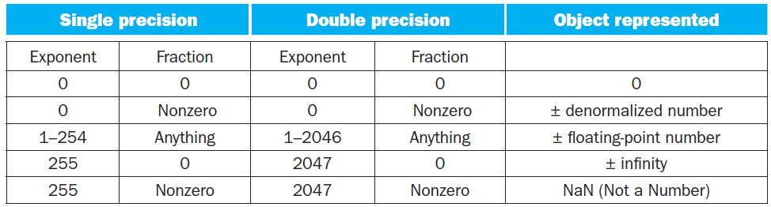
Floating Point Default Values
Chapter 3 — Arithmetic for Computers — <number>

Slide 33


Denormal Numbers
Exponent = 000...0 ⇒ hidden bit is 0
Smaller than normal numbers
  allow for gradual underflow, with diminishing precision
Denormal with fraction = 000...0
Two representations of 0.0!
Chapter 3 — Arithmetic for Computers — <number>
Notes:
Morgan Kaufmann Publishers
Chapter 3 — Arithmetic for Computers

Slide 34
Infinities and NaNs
Exponent = 111...1, Fraction = 000...0
  ±Infinity
  Can be used in subsequent calculations, avoiding need for overflow check
Exponent = 111...1, Fraction ≠ 000...0
  Not-a-Number (NaN)
  Indicates illegal or undefined result
    e.g., 0.0 / 0.0
  Can be used in subsequent calculations
Chapter 3 — Arithmetic for Computers — <number>
Notes:
Morgan Kaufmann Publishers
Chapter 3 — Arithmetic for Computers

Slide 35
Floating-Point Addition
Consider a 4-digit decimal example
  9.999 × 10¹ + 1.610 × 10^{–1}
1. Align decimal points
  Shift number with smaller exponent
  9.999 × 10¹ + 0.016 × 10¹
2. Add significands
  9.999 × 10¹ + 0.016 × 10¹ = 10.015 × 10¹
3. Normalize result & check for over/underflow
  1.0015 × 10²
4. Round and renormalize if necessary
  1.002 × 10²
Chapter 3 — Arithmetic for Computers — <number>
Notes:
Morgan Kaufmann Publishers
Chapter 3 — Arithmetic for Computers

Slide 36
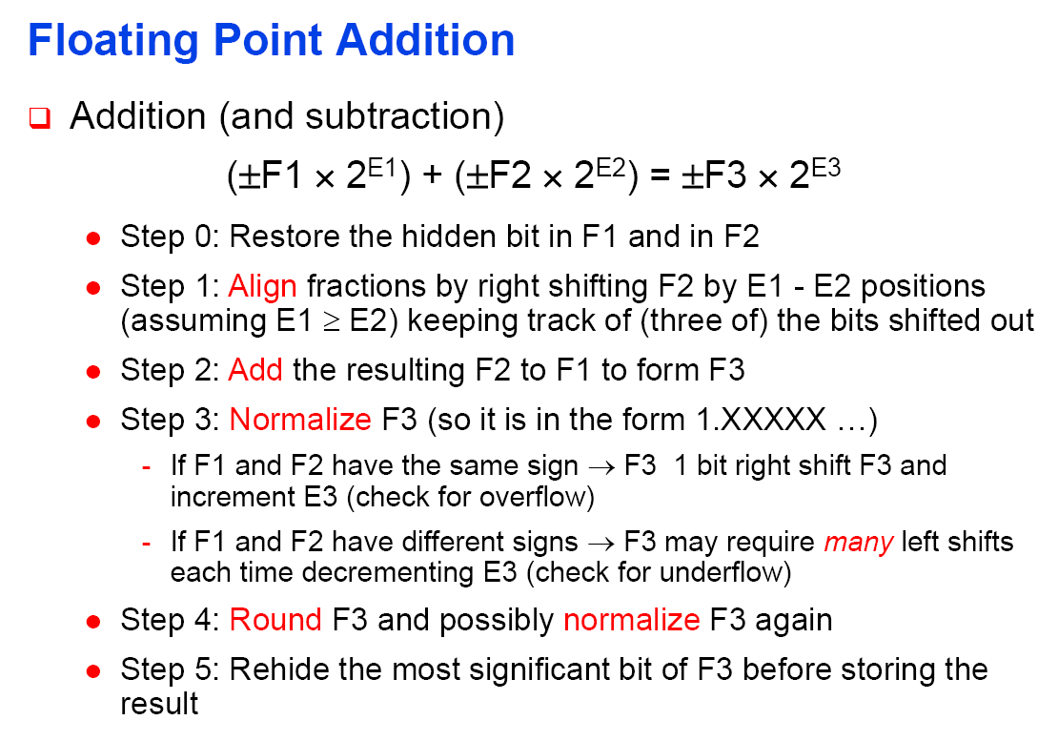

Slide 37
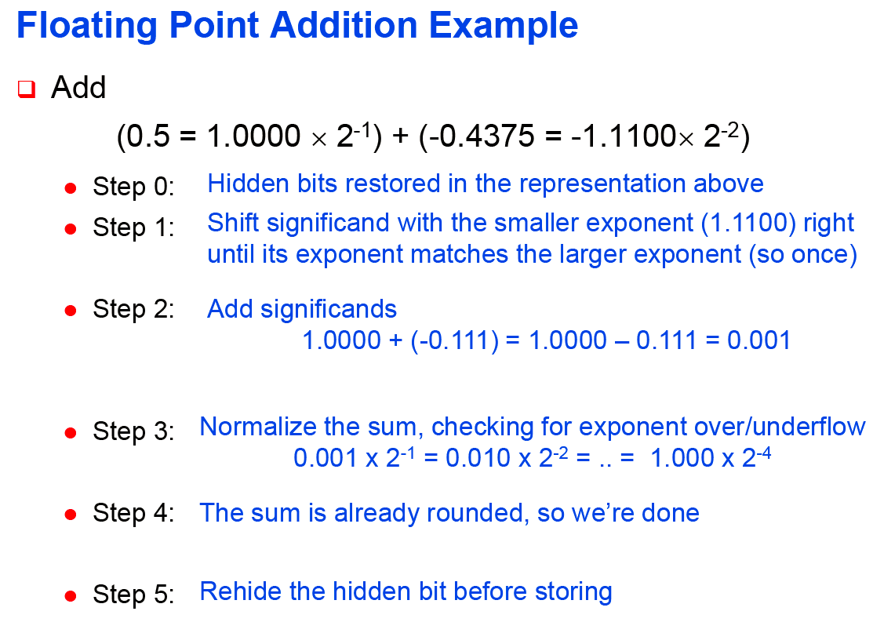

Slide 38
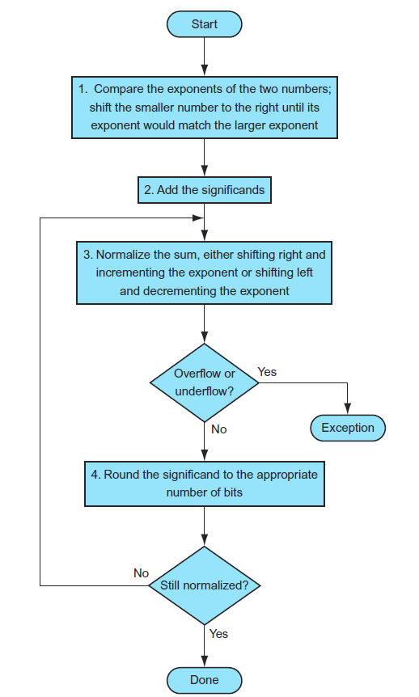
FP Addition Algorithm

Slide 39
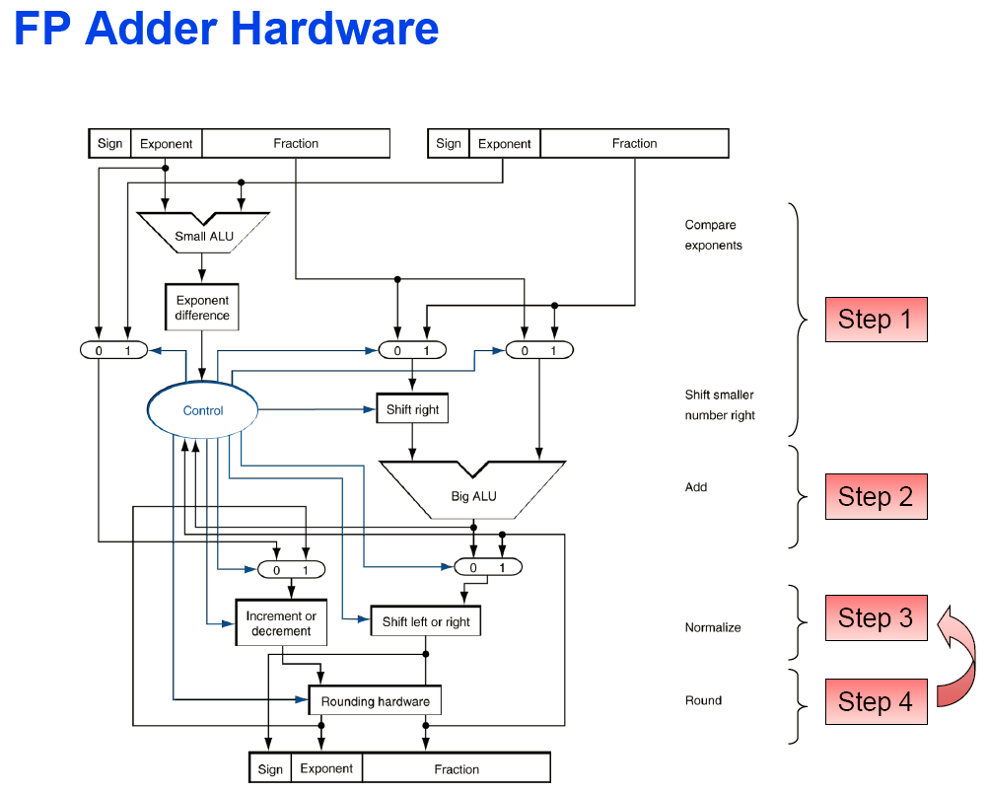

Slide 40
Floating-Point Multiplication
Consider a 4-digit decimal example
  1.110 × 10¹⁰ × 9.200 × 10^{–5}
1. Add exponents
  For biased exponents, subtract bias from sum
  New exponent = 10 + –5 = 5
2. Multiply significands
  1.110 × 9.200 = 10.212 ⇒ 10.212 × 10⁵
3. Normalize result & check for over/underflow
  1.0212 × 10⁶
4. Round and renormalize if necessary
  1.021 × 10⁶
5. Determine sign of result from signs of operands
  +1.021 × 10⁶
Chapter 3 — Arithmetic for Computers — <number>
Notes:
Morgan Kaufmann Publishers
Chapter 3 — Arithmetic for Computers

Slide 41
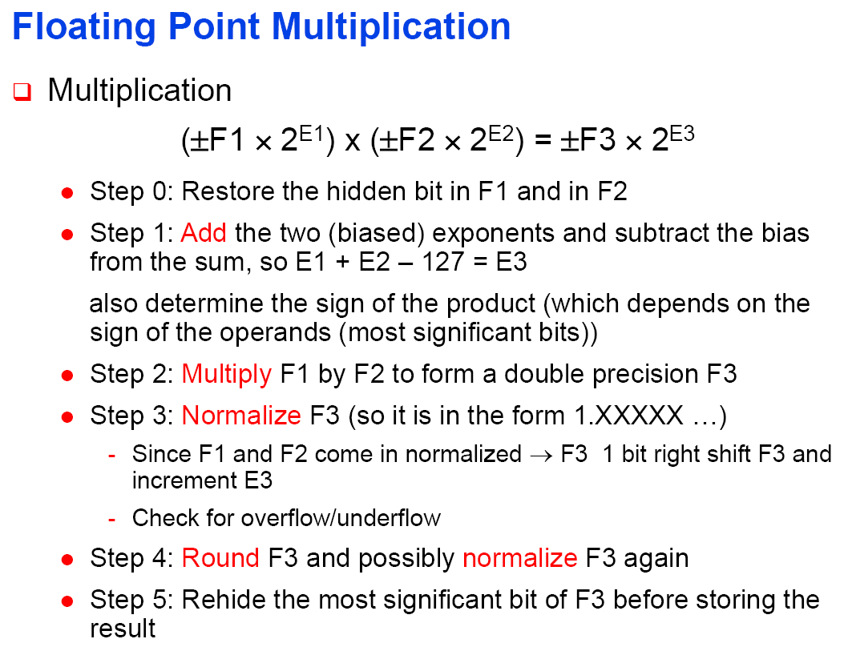

Slide 42
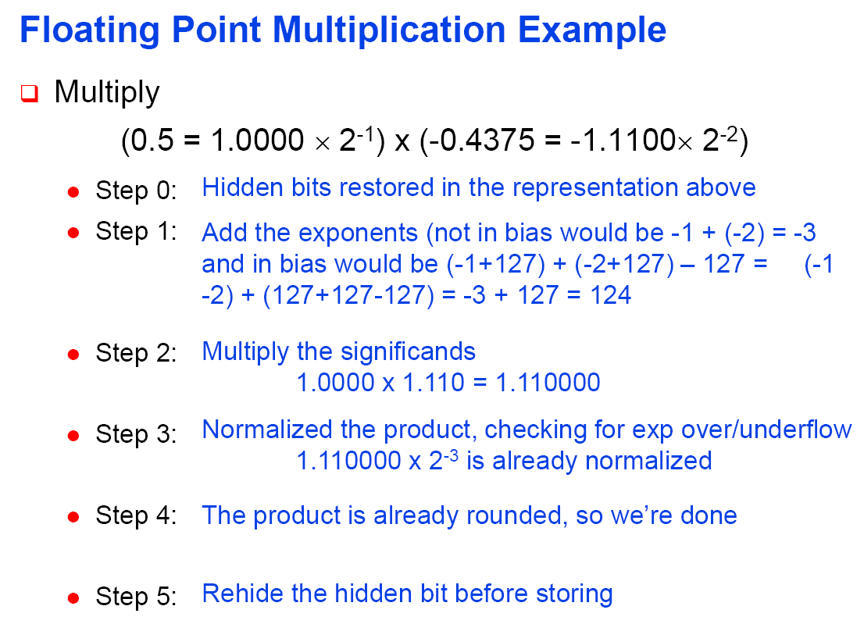

Slide 43
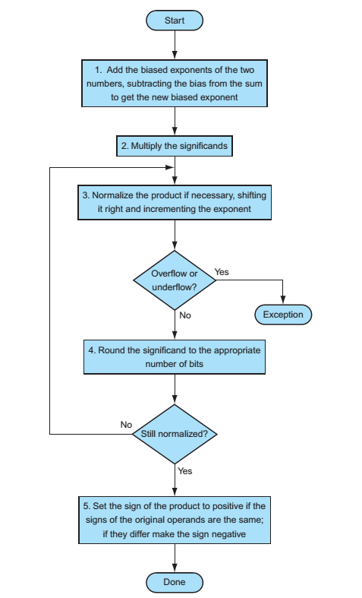
FP Multiplication Algorithm

Slide 44
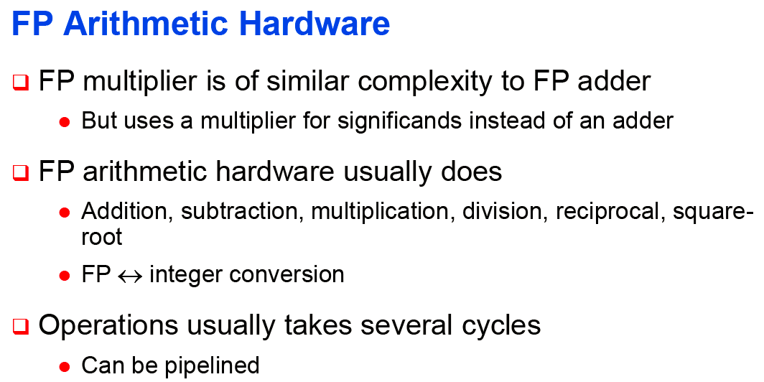

Slide 45
FP Instructions in MIPS
FP hardware is coprocessor 1
  Adjunct processor that extends the ISA
Separate FP registers
  32 single-precision: $f0, $f1, … $f31
  Paired for double-precision: $f0/$f1, $f2/$f3, …
    Release 2 of MIPs ISA supports 32 × 64-bit FP reg’s
FP instructions operate only on FP registers
  Programs generally don’t do integer ops on FP data, or vice versa
  More registers with minimal code-size impact
FP load and store instructions
  lwc1, ldc1, swc1, sdc1
    e.g., ldc1 $f8, 32($sp)
Chapter 3 — Arithmetic for Computers — <number>
Notes:
Morgan Kaufmann Publishers
Chapter 3 — Arithmetic for Computers

Slide 46
FP Instructions in MIPS
Single-precision arithmetic
  add.s, sub.s, mul.s, div.s
    e.g., add.s $f0, $f1, $f6
Double-precision arithmetic
  add.d, sub.d, mul.d, div.d
    e.g., mul.d $f4, $f4, $f6
Single- and double-precision comparison
  c.xx.s, c.xx.d (xx is eq, lt, le, …)
  Sets or clears FP condition-code bit
    e.g. c.lt.s $f3, $f4
Branch on FP condition code true or false
  bc1t, bc1f
    e.g., bc1t TargetLabel
Chapter 3 — Arithmetic for Computers — <number>
Notes:
Morgan Kaufmann Publishers
Chapter 3 — Arithmetic for Computers

Slide 47
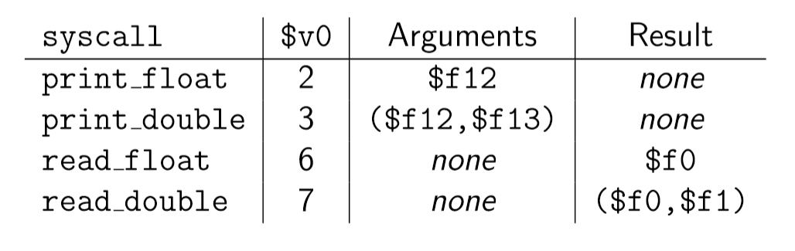
syscall function:
syscall function is used to take input from keyboard and display results on the screen. Content of $v0 defines the different operations of syscall function.
Chapter 3 — Arithmetic for Computers — <number>

Slide 48
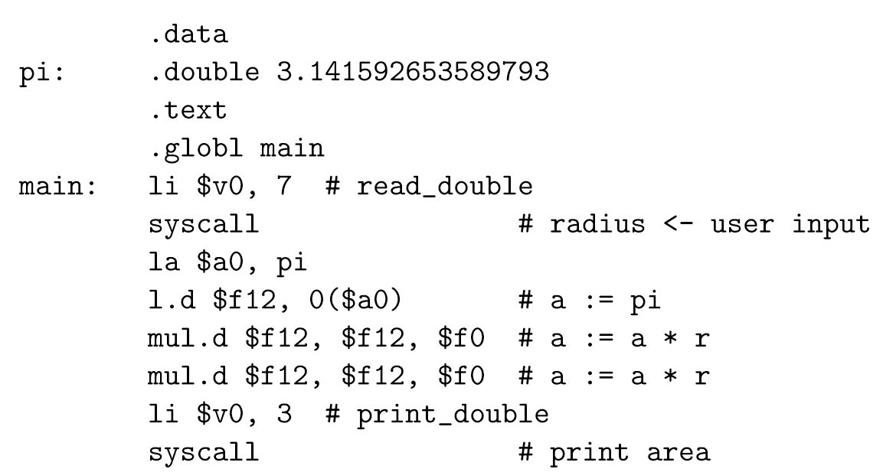
FP Example: Area of a Circle
Chapter 3 — Arithmetic for Computers — <number>

Slide 49
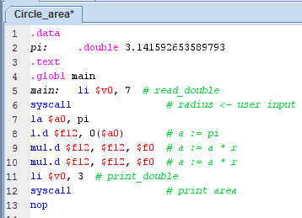
FP Example: Area of a Circle
Chapter 3 — Arithmetic for Computers — <number>

Slide 50
FP Example: °F to °C
C code:
float f2c (float fahr) {
return ((5.0/9.0)*(fahr - 32.0));
}
  fahr in $f12, result in $f0, literals in global memory space
Compiled MIPS code:
f2c: lwc1 $f16, const5($gp)
lwc2 $f18, const9($gp)
div.s $f16, $f16, $f18
lwc1 $f18, const32($gp)
sub.s $f18, $f12, $f18
mul.s $f0, $f16, $f18
jr $ra
Chapter 3 — Arithmetic for Computers — <number>
Notes:
Morgan Kaufmann Publishers
Chapter 3 — Arithmetic for Computers

Slide 51
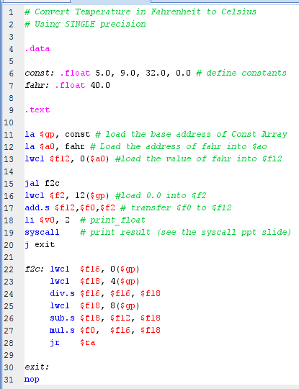
°F to °C using Single precision

Slide 52
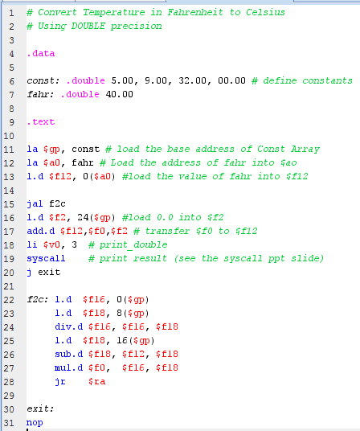
°F to °C using DOUBLE precision

Slide 53
FP Example: Array Multiplication
X = X + Y × Z
  All 32 × 32 matrices, 64-bit double-precision elements
C code:
void mm (double x[][],
double y[][], double z[][]) {
int i, j, k;
for (i = 0; i! = 32; i = i + 1)
for (j = 0; j! = 32; j = j + 1)
for (k = 0; k! = 32; k = k + 1)
x[i][j] = x[i][j]
+ y[i][k] * z[k][j];
}
  Addresses of x, y, z in $a0, $a1, $a2, and
  i, j, k in $s0, $s1, $s2
Chapter 3 — Arithmetic for Computers — <number>
Notes:
Morgan Kaufmann Publishers
Chapter 3 — Arithmetic for Computers

Slide 54
FP Example: Array Multiplication
MIPS code:
li $t1, 32 # $t1 = 32 (row size/loop end)
li $s0, 0 # i = 0; initialize 1st for loop
L1: li $s1, 0 # j = 0; restart 2nd for loop
L2: li $s2, 0 # k = 0; restart 3rd for loop
sll $t2, $s0, 5 # $t2 = i * 32 (size of row of x)
addu $t2, $t2, $s1 # $t2 = i * size(row) + j
sll $t2, $t2, 3 # $t2 = byte offset of [i][j]
addu $t2, $a0, $t2 # $t2 = byte address of x[i][j]
l.d $f4, 0($t2) # $f4 = 8 bytes of x[i][j]
L3: sll $t0, $s2, 5 # $t0 = k * 32 (size of row of z)
addu $t0, $t0, $s1 # $t0 = k * size(row) + j
sll $t0, $t0, 3 # $t0 = byte offset of [k][j]
addu $t0, $a2, $t0 # $t0 = byte address of z[k][j]
l.d $f16, 0($t0) # $f16 = 8 bytes of z[k][j]
…
Chapter 3 — Arithmetic for Computers — <number>
Notes:
Morgan Kaufmann Publishers
Chapter 3 — Arithmetic for Computers

Slide 55
FP Example: Array Multiplication
…
sll $t0, $s0, 5 # $t0 = i*32 (size of row of y)
addu $t0, $t0, $s2 # $t0 = i*size(row) + k
sll $t0, $t0, 3 # $t0 = byte offset of [i][k]
addu $t0, $a1, $t0 # $t0 = byte address of y[i][k]
l.d $f18, 0($t0) # $f18 = 8 bytes of y[i][k]
mul.d $f16, $f18, $f16 # $f16 = y[i][k] * z[k][j]
add.d $f4, $f4, $f16 # f4=x[i][j] + y[i][k]*z[k][j]
addiu $s2, $s2, 1 # $k k + 1
bne $s2, $t1, L3 # if (k != 32) go to L3
s.d $f4, 0($t2) # x[i][j] = $f4
addiu $s1, $s1, 1 # $j = j + 1
bne $s1, $t1, L2 # if (j != 32) go to L2
addiu $s0, $s0, 1 # $i = i + 1
bne $s0, $t1, L1 # if (i != 32) go to L1
Chapter 3 — Arithmetic for Computers — <number>
Notes:
Morgan Kaufmann Publishers
Chapter 3 — Arithmetic for Computers

Slide 56
Accurate Arithmetic
IEEE Std 754 specifies additional rounding control
  Extra bits of precision (guard, round, sticky)
  Choice of rounding modes
  Allows programmer to fine-tune numerical behavior of a computation
Not all FP units implement all options
  Most programming languages and FP libraries just use defaults
Trade-off between hardware complexity, performance, and market requirements
Chapter 3 — Arithmetic for Computers — <number>
Notes:
Morgan Kaufmann Publishers
Chapter 3 — Arithmetic for Computers

Slide 57
Floating-Point Addition
Consider a 4-digit decimal example
  9.999 × 10¹ + 1.610 × 10^{–1}
1. Align decimal points
  Shift number with smaller exponent
  9.999 × 10¹ + 0.016 × 10¹
2. Add significands
  9.999 × 10¹ + 0.016 × 10¹ = 10.015 × 10¹
3. Normalize result & check for over/underflow
  1.0015 × 10²
4. Round and renormalize if necessary
  1.002 × 10²
Chapter 3 — Arithmetic for Computers — <number>
Notes:
Morgan Kaufmann Publishers
Chapter 3 — Arithmetic for Computers

Slide 58
Floating-Point Addition
Now consider a 4-digit binary example
  1.000₂ × 2^{–1} + –1.110₂ × 2^{–2} (0.5 + –0.4375)
1. Align binary points
  Shift number with smaller exponent
  1.000₂ × 2^{–1} + –0.111₂ × 2^{–1}
2. Add significands
  1.000₂ × 2^{–1} + –0.111₂ × 2–1 = 0.001₂ × 2^{–1}
3. Normalize result & check for over/underflow
  1.000₂ × 2^{–4}, with no over/underflow
4. Round and renormalize if necessary
  1.000₂ × 2^{–4} (no change) = 0.0625
Chapter 3 — Arithmetic for Computers — <number>
Notes:
Morgan Kaufmann Publishers
Chapter 3 — Arithmetic for Computers

Slide 59
FP Adder Hardware
Much more complex than integer adder
Doing it in one clock cycle would take too long
  Much longer than integer operations
  Slower clock would penalize all instructions
FP adder usually takes several cycles
  Can be pipelined
Chapter 3 — Arithmetic for Computers — <number>
Notes:
Morgan Kaufmann Publishers
Chapter 3 — Arithmetic for Computers

Slide 60
FP Addition Algorithm

Slide 61

FP Adder Hardware
Step 1
Step 2
Step 3
Step 4
Chapter 3 — Arithmetic for Computers — <number>
Notes:
Morgan Kaufmann Publishers
Chapter 3 — Arithmetic for Computers

Slide 62
Floating-Point Multiplication
Consider a 4-digit decimal example
  1.110 × 10¹⁰ × 9.200 × 10^{–5}
1. Add exponents
  For biased exponents, subtract bias from sum
  New exponent = 10 + –5 = 5
2. Multiply significands
  1.110 × 9.200 = 10.212 ⇒ 10.212 × 10⁵
3. Normalize result & check for over/underflow
  1.0212 × 10⁶
4. Round and renormalize if necessary
  1.021 × 10⁶
5. Determine sign of result from signs of operands
  +1.021 × 10⁶
Chapter 3 — Arithmetic for Computers — <number>
Notes:
Morgan Kaufmann Publishers
Chapter 3 — Arithmetic for Computers

Slide 63
Floating-Point Multiplication
Now consider a 4-digit binary example
  1.000₂ × 2^{–1} × –1.110₂ × 2^{–2} (0.5 × –0.4375)
1. Add exponents
  Unbiased: –1 + –2 = –3
  Biased: (–1 + 127) + (–2 + 127) = –3 + 254 – 127 = –3 + 127
2. Multiply significands
  1.000₂ × 1.110₂ = 1.1102 ⇒ 1.110₂ × 2^{–3}
3. Normalize result & check for over/underflow
  1.110₂ × 2^{–3} (no change) with no over/underflow
4. Round and renormalize if necessary
  1.110₂ × 2^{–3} (no change)
5. Determine sign: +ve × –ve ⇒ –ve
  –1.110₂ × 2^{–3} = –0.21875
Chapter 3 — Arithmetic for Computers — <number>
Notes:
Morgan Kaufmann Publishers
Chapter 3 — Arithmetic for Computers

Slide 64
FP Arithmetic Hardware
FP multiplier is of similar complexity to FP adder
  But uses a multiplier for significands instead of an adder
FP arithmetic hardware usually does
  Addition, subtraction, multiplication, division, reciprocal, square-root
  FP ↔ integer conversion
Operations usually takes several cycles
  Can be pipelined
Chapter 3 — Arithmetic for Computers — <number>
Notes:
Morgan Kaufmann Publishers
Chapter 3 — Arithmetic for Computers

